Slide 1


Slide 2
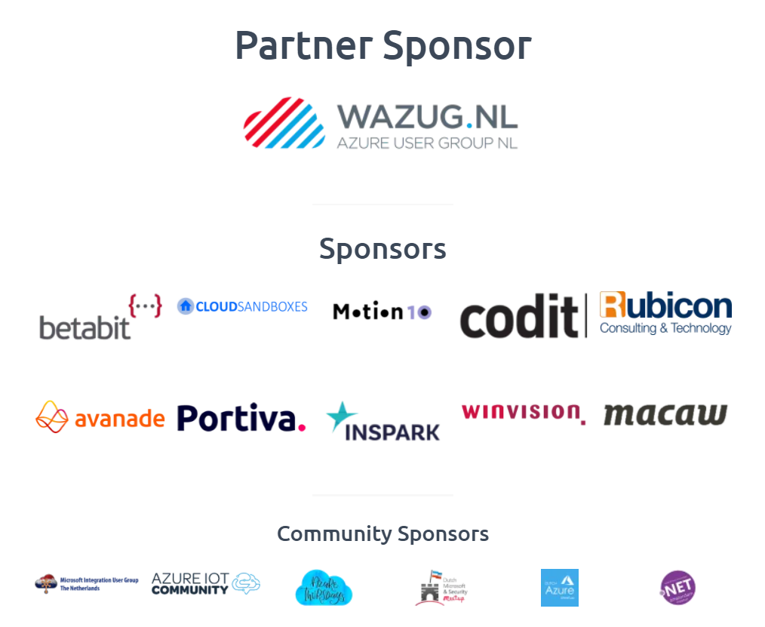
A special thank you to the sponsors!

Slide 3
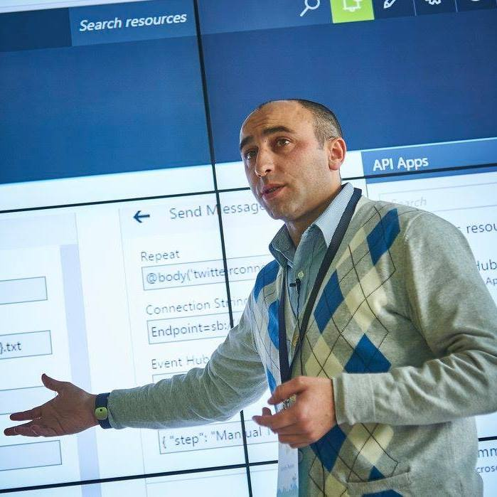


Sandro Pereira
Head of Integration @DevScope
Microsoft Azure MVP
sandro.pereira@devscope.net
linkedin.com/in/sandropereira
@sandro_asp
https://blog.sandro-pereira.com/
Public speaker
Father
Book author: “BizTalk Mapping Patterns and Best Practices”
+351 223 751 350
www.devscope.net
Notes:
Interested in all things integration – which of course includes MS Flow

Slide 4




LOCKDOWN
WE NEVER KNOW WHAT WILL HAPPEN!

Slide 5

designing a solution or application… is quick easy
@sandro_asp

Slide 6

but me need to start thinking on the people
that will manage them…
@sandro_asp

Slide 7

no need to worry…
we monitor everything…
@sandro_asp

Slide 8

and guess what?
When disaster happens
you are the last
to know…
@sandro_asp

Slide 9
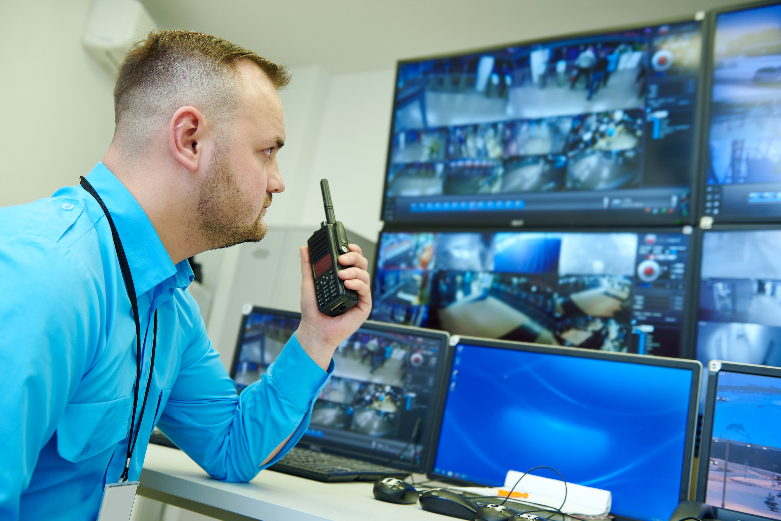
monitoring should be key
piece of your solutions
@sandro_asp

Slide 10

How to create robust monitor solutions with PowerShell, Azure Functions and Logic Apps
@sandro_asp

Slide 11
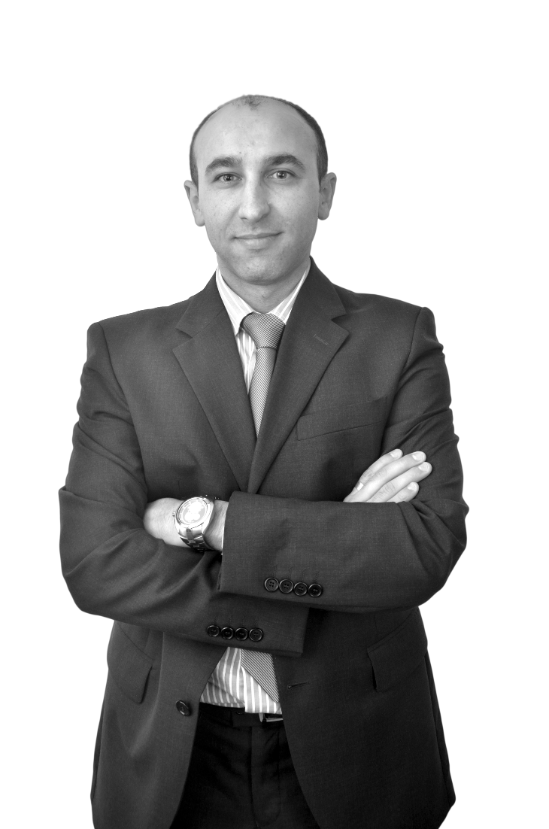


Thanks
DevScope
+351 223 751 350
support@devscope.net
https://pt.linkedin.com/company/devscope
@DevScope
www.devscope.net
Sandro Pereira
sandro.pereira@devscope.net
linkedin.com/in/sandropereira
@sandro_asp
https://blog.sandro-pereira.com/
SANDRO PEREIRA
HEAD OF INTEGRATION @ DEVSCOPE
MICROSOFT AZURE MVP

